Slide 1
NS TOWER
Software Studio 軟體設計與實驗
Hung-Kuo Chu
Department of Computer Science
National Tsing Hua University
CS2410

Slide 2
Important
We use Cocos Creator 2.2.2 in this course.
Please make sure you use the same version, otherwise your program may crash when we test it.

Slide 3
Goal
Fork repo Lab11-NS-TOWER to your local repository.
Complete all TODOs written in GameMgr.ts and Platform.ts to create an platform game.

Slide 4
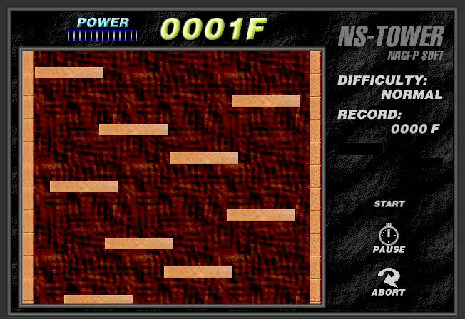
Goal (Cont'd)
Example Result
DEMO URL: https://105062302.gitlab.io/lab11-demo

Slide 5
Goal (Cont'd)
Deadline: 2020/05/28 18:00 (FTP upload time)
Please upload your source files to FTP and name your zip file as the following name format. Otherwise you will get 0 point.
Lab11_[studentID]_v1.zip
Lab11_[studentID]_v2.zip
…

Slide 6
Grading Policy
Conveyor platform has delivery effect when player touches it. 5%
Cancel delivery effect when the player leaves Conveyor platforms. 5%
All the platforms have only upside collision. You have to prevent collisions from the other directions. 15%
Platforms have correct moving action. 25%
Platforms have easing effect. 10%

Slide 7
Grading Policy
When user presses mouse, the energy bar can keep gathering. 10%
When user releases mouse, the energy bar can stop gathering. 10%
Player jumps according to the value of energy bar. 10%
When player falls down, the energy bar can stop gathering. 10%
You will get 0 point if your program crashes during the test.

Slide 8
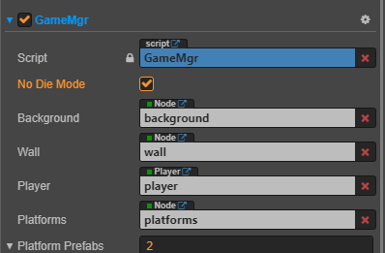
Debug Mode
You can use “Debug Mode” to prevent player from death.

Slide 9
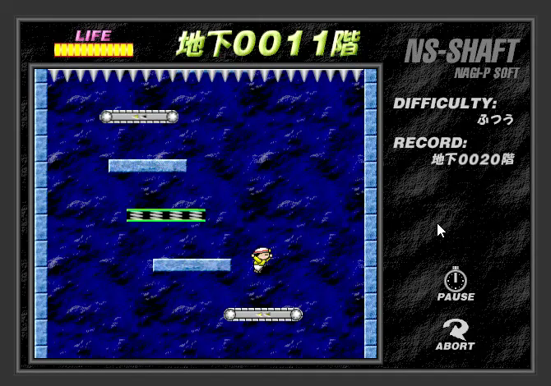
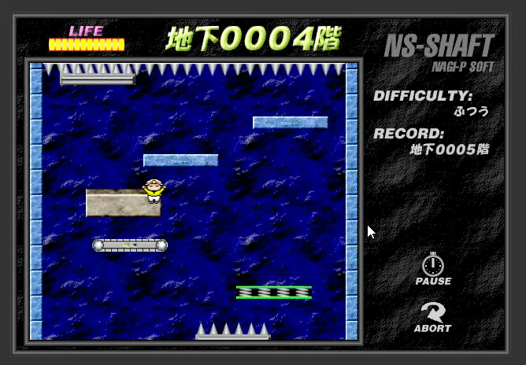
Cancellation of Delivery Effect
(O) Cancel delivery effect after leaving
(X) Do not cancel delivery effect
after leaving

Slide 10
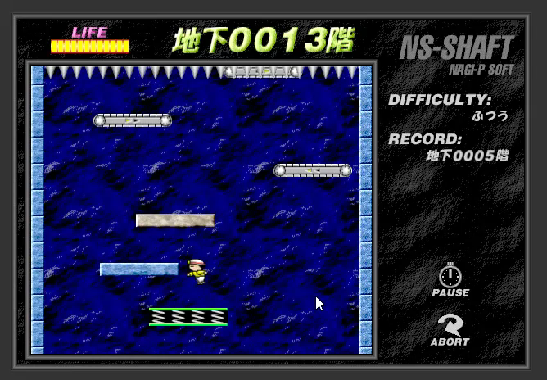
One Side Collision

Slide 11
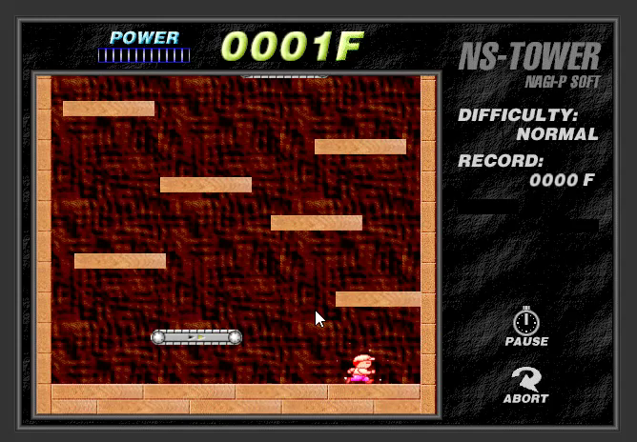
Energy Gathering

Slide 12
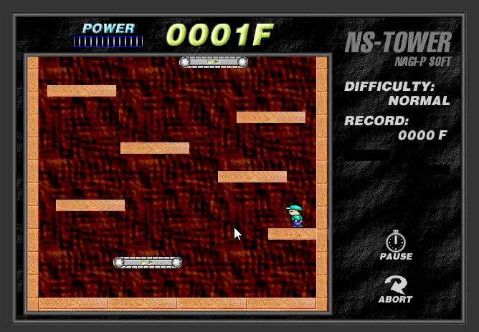
Cancellation of Energy Gathering

Slide 13
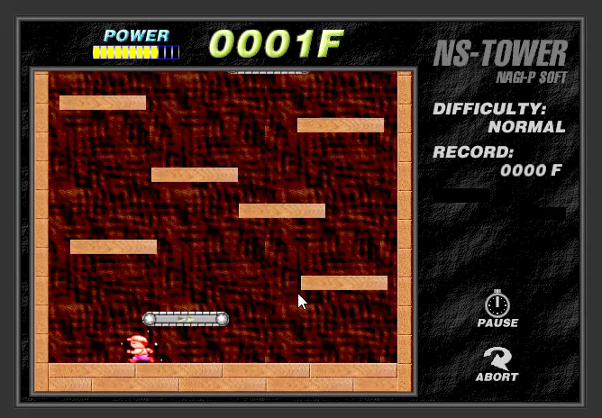
Player Jump

Slide 14
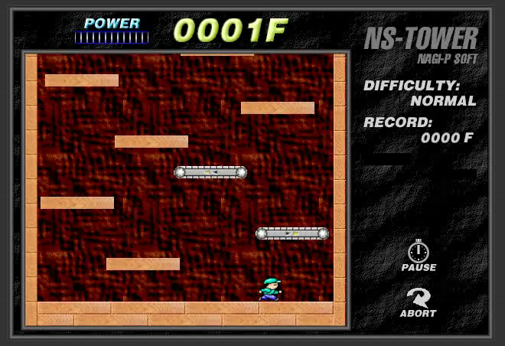
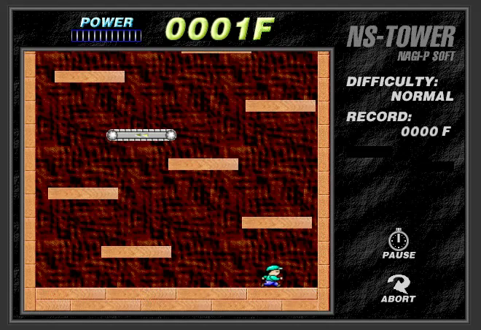
Platform Easing Effect
(O) Have easing effect
(X) Do not have easing effect

